Slide 1


Write it Right!

Slide 2
Write it Right: What we will cover
Written Estimates
Claim Checks
Invoices
Diagnostic Fees and Service Calls
Unusual Circumstances
Advertising
Guarantees

Slide 3
Need More Help?
Email: homeproducts@dca.ca.gov
Phone: (916) 999-2041
Text of EAR Law and Regulations

Slide 4
Written Estimates
A service dealer may not perform repairs or charge a customer for repairs until the customer has been provided with an estimate in writing and the customer specifically authorized the repairs.

Slide 5
Written Estimates (2)
After a written estimate has been provided to the customer the service dealer may not charge for work done or parts supplied in excess of the written estimate without the prior oral or written consent of the customer. If such consent is oral the service dealer shall make a notation on the invoice of the date, time and name of person authorizing the additional repairs.

Slide 6
Written Estimates (3)
Where a written estimate is provided in the residence the estimate shall include as part of the labor charge:
  transportation and travel charges
  initial service call charge (if any)
Remember - SALES TAX and other applicable taxes shall not be considered as part of the written estimate.

Slide 7
Written Estimates (4)
“Don’ts” in your estimates
  Don’t give a minimum or maximum estimate!
  Don’t exclude costs (except for taxes) from your estimate. Estimates must include all charges!
  Don’t just give an oral estimate – be sure you provide an estimate in writing first!

Slide 8
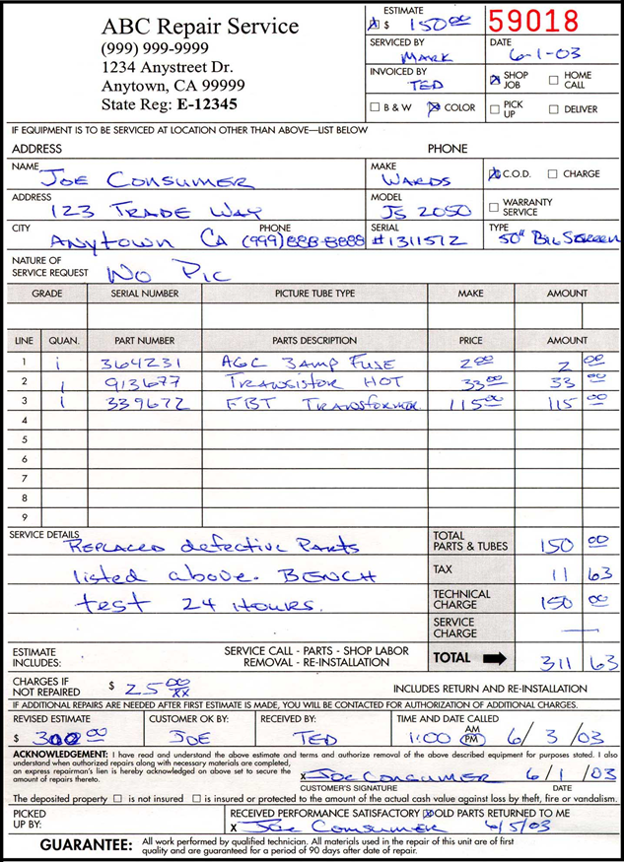
Written Estimates (5)
Example of a properly written estimate.

Slide 9
Written Estimates (6)
Legal References:
  Business and Professions Code §9844
  California Code of Regulations §2722

Slide 10

Claim Checks
A claim check is required when:
  You remove a product from the home, home office, or private motor vehicle.
  You accept a set or appliance for repair at your place of business.

Slide 11
Claim Checks (2)
What needs to be on your Claim Check:
  The name and registration number of the service dealer and the address and telephone number of the location where the set or appliance will be repaired.
  The date the set or appliance was accepted or received by the service dealer.
  A description of the item.
  A description of the problem with the item.

Slide 12
Claim Checks (3)
What needs to be on your Claim Check (cont.):
  The name and address of the customer.
  The signature of the person receiving the item.
  Removal and/or installation charge (if any)
  Whether or not the item is protected to the amount of the actual cash value while with the service dealer.

Slide 13
Claim Checks (4)
What needs to be on your Claim Check (cont.):
  In prominent type, the following statement:
  “An estimate as required (Section 9844 of the California Business and Professions Code) for repairs shall be given to the customer by the service dealer in writing, and the service dealer may not charge for work done or parts supplied in excess of the estimate without prior consent of the customer. Where provided in writing, the service dealer may charge a reasonable fee for services provided in determining the nature of the malfunction in preparation of a written estimate for repair. For information contact the Bureau of Household Goods and Services, Department of Consumer Affairs, Sacramento 95834."

Slide 14
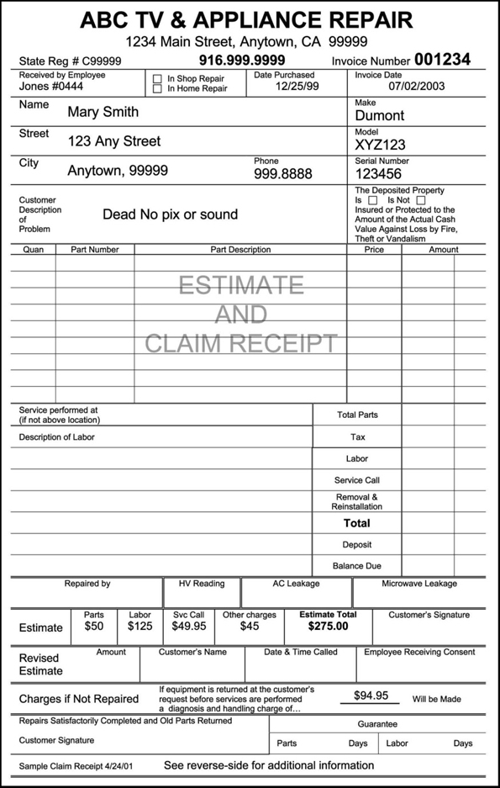
Claim Checks (5)
Example of how a claim check form should look. (front)

Slide 15
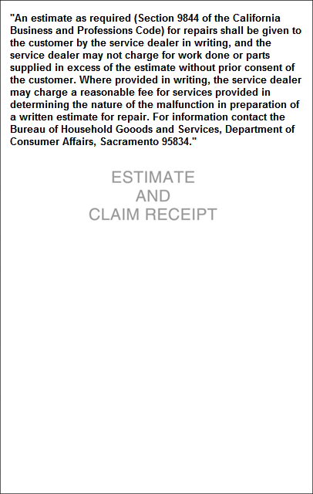
Claim Checks (6)
Example (back)
  This statement may appear on the front or back of the claim check.

Slide 16
Claim Checks (7)
Where in the code section does it specify claim check requirements?
  Business and Professions Code §9844
  California Code of Regulations §2721

Slide 17
Invoices
An invoice must contain:
  Business Name, Address and Telephone Number
  State Registration Number
  Date of Invoice
  If the unit is removed, the invoice must indicate the address of the location where the set is repaired.

Slide 18
Invoices (2)
An invoice must contain (cont.):
  Description of the unit, including make, model and serial number
  Name and Address of the Customer
  A summary of the customer’s description of what’s wrong with the unit
  Itemization of each part replaced in the unit, indicating warranty or charge for each part

Slide 19
Invoices (3)
An invoice must contain (cont.):
  Itemization and description of labor or technical services performed within warranty or for which a charge was levied
  An itemization and description of all other charges
  If used or exchanged parts are used, a statement indicating which part is non-new

Slide 20
Invoices (4)
An invoice must contain (cont.):
  Signature or employee number filling out the invoice
  A statement of total charges
  Signature or employee number performing the actual repair

Slide 21
Invoices (5)
An invoice must contain (cont.):
  In prominent type, the following statement:
  “An estimate as required (Section 9844 of the California Business and Professions Code) for repairs shall be given to the customer by the service dealer in writing, and the service dealer may not charge for work done or parts supplied in excess of the estimate without prior consent of the customer. Where provided in writing, the service dealer may charge a reasonable fee for services provided in determining the nature of the malfunction in preparation of a written estimate for repair. For information contact the Bureau of Household Goods and Services, Department of Consumer Affairs, Sacramento 95834”

Slide 22
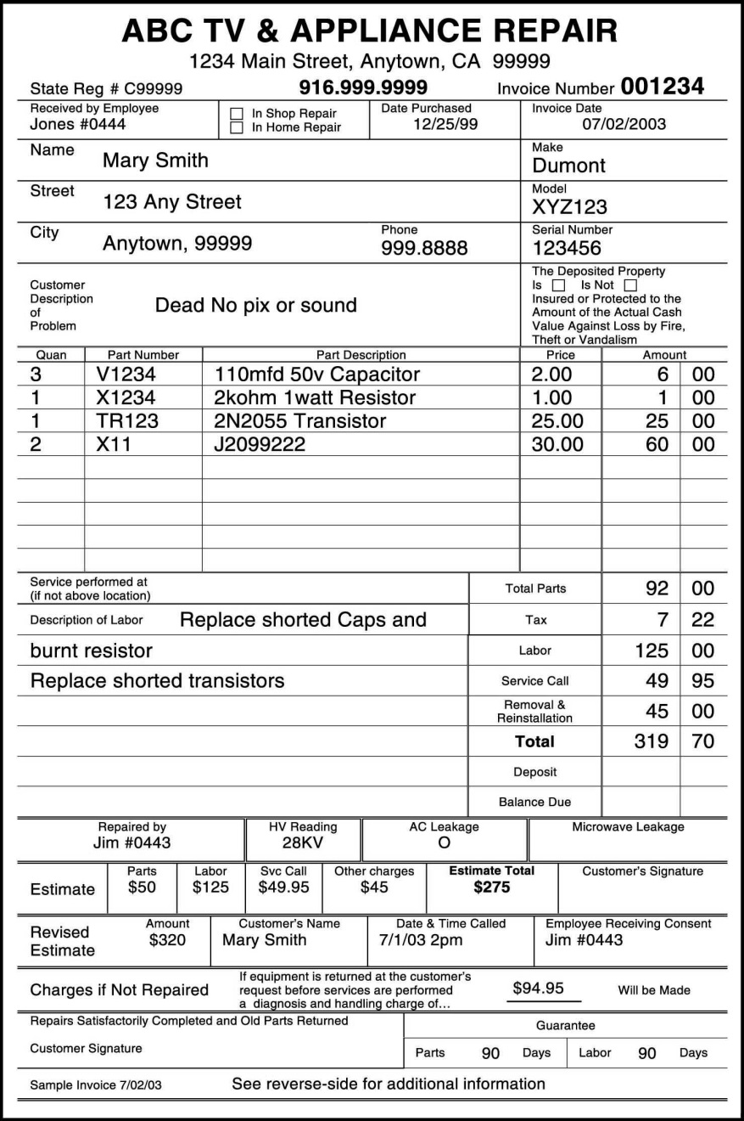
Invoices (6)
Example (Front)

Slide 23

Invoices (7)
Example (Back)

Slide 24
Invoices (8)
References in the Law
  Business and Professions Code §9842
  California Code of Regulations §2725

Slide 25
Diagnostic Fees and Service Calls
A reasonable fee can be charged for diagnosing the malfunction in preparation of a written estimate for repair, provided that the customer was notified of the fee in writing prior to any work being performed.
If the unit is repaired in the home, the customer must be notified of any fee for the preparation of a written estimate, in writing, prior to any work being done or the unit being removed from the home.
Unless received by public carrier, the diagnosis fee must include any transportation or travel cost in conjunction with the diagnosis.

Slide 26
Diagnostic Fees and Service Calls (2)
The service dealer shall quote a charge for each service call, and the diagnosis fee, if one is to be charged, prior to making each service call.
If a diagnosis fee is charged, it shall be included in the service call charge.

Slide 27
Diagnostic Fees and Service Calls (3)
References in the Law
  Business and Professions Code §9844
  California Code of Regulations §2722.5

Slide 28
Unusual Circumstances
Sometimes, unusual circumstances occur in which standard practices cannot be followed.
Many of these circumstances are covered in California Code of Regulations §2722.6.
When in doubt, contact the Bureau for assistance and guidance.

Slide 29
Guarantee of Work
If a guarantee is used in conjunction with a repair or install the following must be provided in writing:
  Nature and extent of the guarantee.
  Identity of the guarantor.
If a partial/no guarantee is provided:
  The invoice must state what portion of the service is not covered by a guarantee.
If not stated in the invoice, it will be assumed that the service is covered by an implied 30-day labor and 90-day parts guarantee.

Slide 30
Guarantee of Work (2)
References in the Law
  Business and Professions Code §9846
  California Code of Regulations §2736

Slide 31
For More Information
You can visit the Bureau online for more information at:
  www.bhgs.dca.ca.gov
Or contact us at:
  homeproduct@dca.ca.gov
  (916) 999-2041

